Slide 1


Fundamental Kubernetes Training Labs
(v0.8)
last update: 2018/12/01
Sources from and thanks to Michael Hausenblas, Marko Lukša, Bob Killen
Presenter: Arash Kaffamanesh

Slide 2
About this project
This k8s trainings slides are created for everyone who’d like to use it for k8s fundamental trainings
The video recording of one of our tainings is available here →
GET STARTED, ingress point :-) is here →
Additional study guides and training material will be developed for CKA and CKAD Candidates →
For more information please join us on slack →
If you’d like to become a CKA(D), please ask to join the CKA(D)s channel, everyone in the group can add you to the CKA(D)s channel

Slide 3
How to prepare for online trainings (1)
Install minikube →
Install minishift (OKD) →
Install a k8s-vagrant-multi-node cluster →
Or Kubeadm DinD Cluster →
Optional: you need an account on GCP with billing enabled
Get started with $300 free credits →
Create a project and enable GKE service
Install gcloud SDK / CLI: →
Source: https://kubernauts.gitbooks.io/kubernauts-kubernetes-training-courses/content/courses/novice.html

Slide 4
How to prepare for online trainings (2)
Optional: create a Kubernetes Cluster on AWS or OpenStack
Use Kubernauts’ TK8 installer for AWS, OpenStack and Bare-Metal →
Use Kubernauts’ TK8EKS installer for AWS, OpenStack and Bare-Metal →
Use our Kops Faststart guide for AWS →
Use Heptio’s Quickstart for AWS →
New: use Dave Karre’s OKD 3.10 implementation →
Source: https://kubernauts.gitbooks.io/kubernauts-kubernetes-training-courses/content/courses/novice.html

Slide 5
How to prepare for online trainings (3)
Checkout the code of Kubernetes By Example $ git clone https://github.com/openshift-evangelists/kbe
Checkout the code of Kubernetes By Action $ git clone https://github.com/luksa/kubernetes-in-action.git
Checkout the code of K8s intro tutorials $ git clone https://github.com/mrbobbytables/k8s-intro-tutorials
Source: https://kubernauts.gitbooks.io/kubernauts-kubernetes-training-courses/content/courses/novice.html

Slide 6
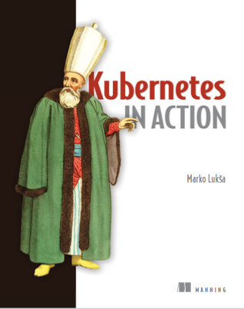
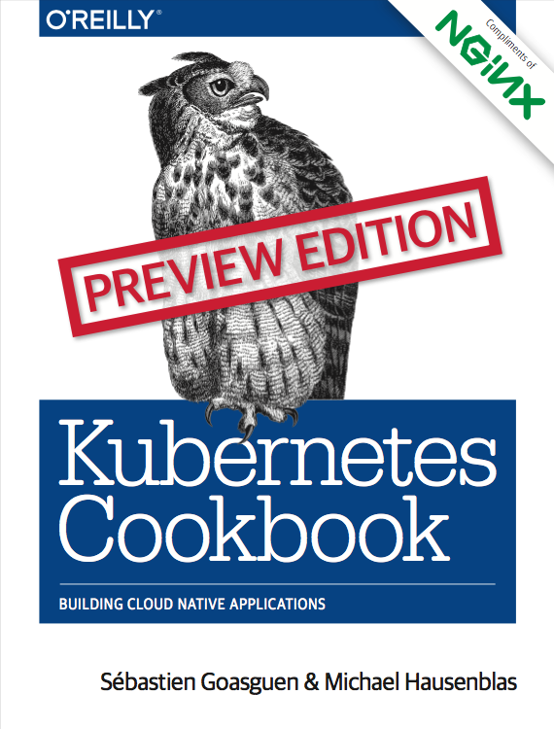
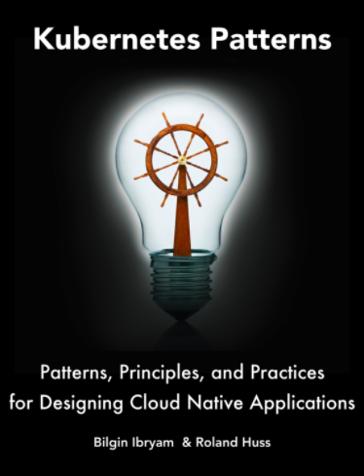
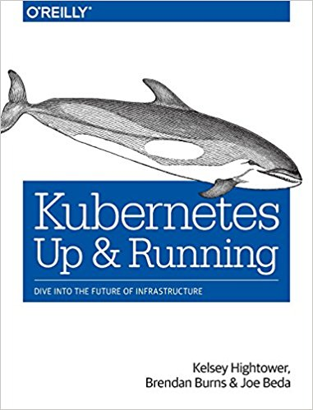
Kubernetes Learning Resources List
Everything you need to know about Kubernetes & more:
https://goo.gl/Rywkpd
Recommended Books and references:

Slide 7
TOPICS (1)
What is Kubernetes (“k8s” or “kube”)
Kubernetes Architecture
Core Concepts of Kubernetes
Kubernetes resources explained
Application dependency on Kubernetes primitives
Kubernetes effect on the software development life cycle
Local and Distributed Abstractions and Primitives
Container Design Patterns and best practices
Deployment and release strategy with Kubernetes

Slide 8
TOPICS (2)
Kubernetes v1.8: A Comprehensive Overview →
Getting started with Kubernetes
Get started with k8s w/o installation with Katacoda →
Install k8s everywhere
Play with Simple Apps on k8s
Kubernetes by Example →
Deploying and Updating App with Kubernetes
Deploy complex apps on k8s

Slide 9
TOPICS (3)
Kubectl: manage k8s resources
Kubectl in action →
Kubernetes Admin Helper →
Kubernetes & the Container Ecosystem →
Kubernetes & Helm, Kedge & Co.
Extending Kubernetes
Exercises
Horizontal Pod Autoscaling (HPA)
Troubleshooting & Maintenance (wip)

Slide 10
TOPICS (4)
Resources for CKA(D) Candidates
Curriculum for CNCF Certification Courses →
Please refer to the section “For CKA Candidates” →

Slide 11
What Is Kubernetes?
Kubernetes is the linux kernel of distributed systems
Kubernetes is the linux of the cloud!
Kubernetes is a platform and container orchestration tool for automating deployment, scaling, and operations of application containers.
Kubernetes supports Containerd (docker), Rkt, Cri-o containers. Kata (formerly clear and hyper) and Virtlet support are coming soon.
Notes:
Note: A container runtime is a CRI (Container Runtime Interface) compatible application that executes and manages containers!

Slide 12
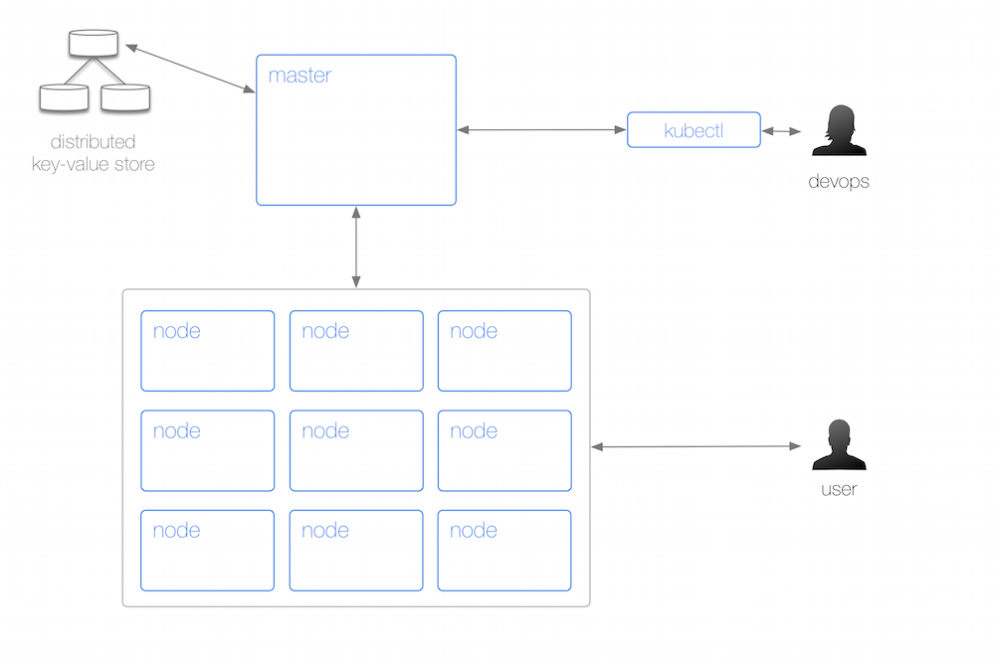
Kubernetes Architecture (physical layout)
Source: http://k8s.info/cs.html#cs-menu
Notes:
From a physical perspective, a Kubernetes cluster consists of:
A master (with several independent sub-components, details below) that coordinates the work.
A distributed key-value store, currently etcd, for maintaining the resource state in a persistent and reliable manner, throughout the cluster.
A number of nodes that carry out the work.
A command line tool called kubectl allowing to query and manipulate the cluster state; this is a fancy way of saying: running containers, creating services and administrating the cluster (logging, monitoring, debugging).

Slide 13
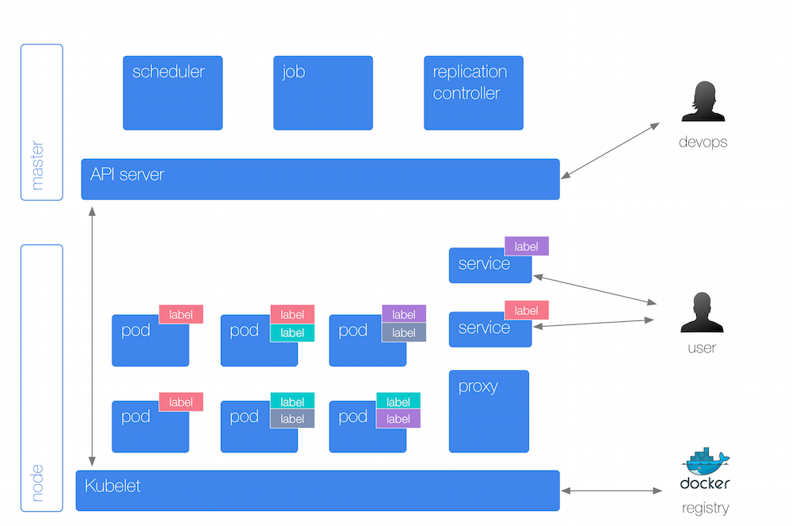
Kubernetes Architecture (abstraction overview)
Source: http://k8s.info/cs.html#cs-menu
Notes:
A Kubernetes cluster is a set of physical or virtual machines and other infrastructure resources that are used to run your applications. The machines that manage the cluster are called Master Nodes and the machines that run the containers are called Worker Nodes.
NODE
A Node is a physical or virtual machine. It has the necessary services to run application containers.
A Master Node is the central control point that provides a unified view of the cluster. Multiple masters can be setup to create a highly- available cluster.
A Worker Node runs tasks as delegated by the master. Each Worker Node can run multiple pods.
KUBELET
Kubelet is a service running on each Node that manages containers and is managed by the master. This service reads container manifests as YAML or JSON files that describe each Pod. A typical way to provide this manifest is using the configuration file as shown in the previous sections. Kubelet ensures that the containers defined in the Pods are started and continue running.
Kubelet is a Kubernetes-internal concept and generally does not require direct manipulation

Slide 14
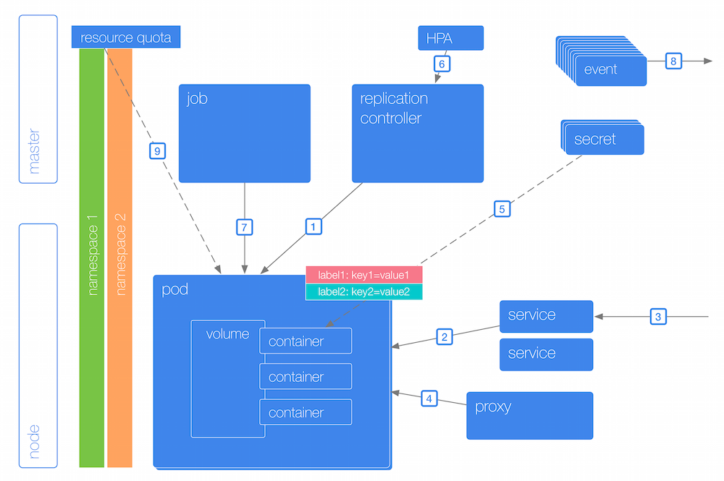
Kubernetes Architecture (abstraction details)
Source: http://k8s.info/cs.html#cs-menu
Notes:
The interactions are as follows:
A replication controller (RC) looks after one or more pods. The RC keeps a number of pods (so called replicas) up and running.
To launch a pod and implicitly create a RC: kubectl run ubuntu --image=ubuntu
To create a RC from a manifest, use: kubectl create -f nginx-rc.yaml. See the YAML formatted RC manifest file itself for the actual definition.
To list all RCs in a certain namespace:kubectl get rc --namespace="kube-system"
To change the number of pods in a RC, scale it like so: kubectl scale --replicas=2 rc nginx
Containers in a pod may use ephemeral local disk space but for sustainable, persistent scenarios as well as sharing data between containers in a pod you can use volumes.
Implement health checks via readinessProbe and livenessProbe fields on the pod-level.
A service represents a logical group of pods (backed by a RC). It provides a stable interface to interact with the pods. To create a service from a YAML file, use: kubectl create -f my-service.yaml. The service selects the targeted pods it routes traffic to via labels, for example, to list all pods labelled with 'app=webserver' use:
kubectl get pods -l="app=webserver".
From either the end-user perspective or other services in a cluster, one interacts with a service. To expose a RC named 'nginx' that has a pod serving on port 8000 as a service on port 80, use kubectl expose rc nginx --port=80 --target-port=8000. Also to list the endpoints, use: kubectl get ep
On each node a local proxy runs that provides for basic service discovery and load balancing.
A container in a pod may use one or more secrets to handle sensitive information such as passwords or API credentials. To list all secrets, use: kubectl get secrets
A autoscaler is available on a per-RC basis. It scales the replicas depending on the average CPU utilization of the RC's pods.
For batch workloads, you can use jobs. To view completed pods of a job, use: kubectl get pods --show-all
Changes to resources such as pods, RCs, services, etc. are available through events: kubectl get events
To separate users, groups or applications use namespaces.To list all namespaces, use: kubectl get ns and to see the resource quotas of a namespace use kubectl get quota. When a pod doesn't specify its resource constraints such as CPU shares or memory requested it effectively can consume unbounded resources. You really want to specify default limits along with the quotas. Note: while quotas work on the namespace-level for, say, entire groups of users or projects, the limits work on a per-pod level.

Slide 15
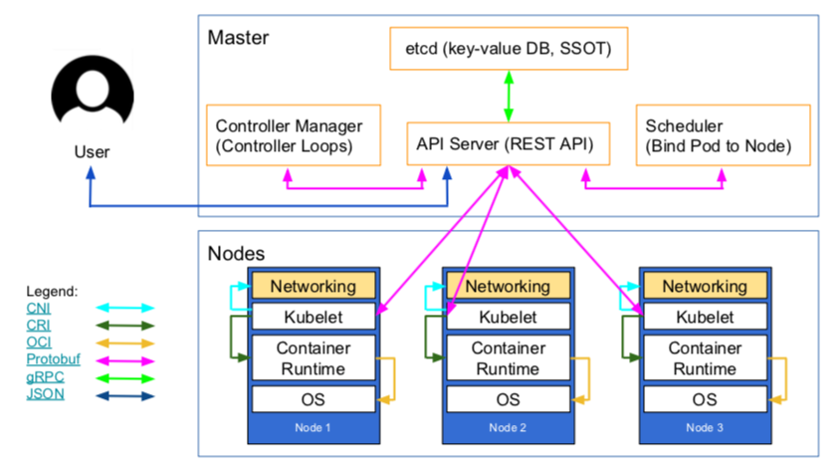
Kubernetes’ High-Level Architecture Overview
Source: https://www.weave.works/blog/what-does-production-ready-really-mean-for-a-kubernetes-cluster

Slide 16
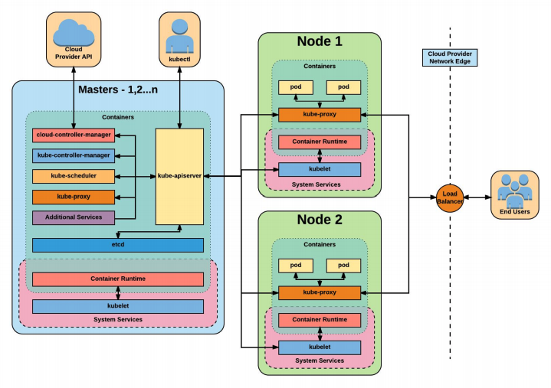
Kubernetes Architecture Overview
Source: Kubernetes - a comprehensive Overview
Notes:
Architecture Overview
Masters - Acts as the primary control plane for Kubernetes. Masters are responsible at a minimum for running the API Server, scheduler, and cluster controller. They commonly also manage storing cluster state, cloud-provider specific components and other cluster essential services. Nodes - Are the ‘workers’ of a Kubernetes cluster. They run a minimal agent that manages the node itself, and are tasked with executing workloads as designated by the master.

Slide 17
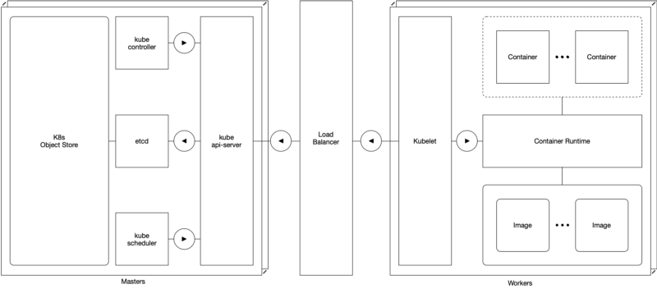
Kubernetes HA
Don’t miss: https://medium.com/@dominik.tornow/kubernetes-high-availability-d2c9cbbdd864

Slide 18
Core Concepts of Kubernetes (1)
Pod →
Label and selectors →
Controllers
Deployments →
ReplicaSet →
ReplicationController →
DaemonSet →
Service →

Slide 19
Core Concepts of Kubernetes (2)
StatefulSets →
ConfigMaps →
Secrets →
Persistent Volumes (attaching storage to containers) →
Life Cycle of Applications in Kubernetes →
Updating Pods
Rolling updates
Rollback

Slide 20
Kubernetes resources explained (1)
 | Resource (abbr.) [API version] | Description
 | Namespace* (ns) [v1] | Enables organizing resources into non-overlapping groups (for example, per tenant)
Deploying Workloads | Pod (po) [v1] ReplicaSet ReplicationController Job CronJob DaemonSet StatefulSet Deployment | The basic deployable unit containing one or more processes in co-located containers Keeps one or more pod replicas running The older, less-powerful equivalent of a ReplicaSet Runs pods that perform a completable task Runs a scheduled job once or periodically Runs one pod replica per node (on all nodes or only on those matching a node selector) Runs stateful pods with a stable identity Declarative deployment and updates of pods
Source: Kubernetes in Action book by Marko Lukša

Slide 21
Kubernetes resources explained (2)
 | Resource (abbr.) [API version] | Description
Services | Service (svc) [v1] Endpoints (ep) [v1] Ingress (ing) [extensions/v1beta1] | Exposes one or more pods at a single and stable IP address and port pair Defines which pods (or other servers) are exposed through a service Exposes one or more services to external clients through a single externally reachable IP address
Config | ConfigMap (cm) [v1] Secret [v1] | A key-value map for storing non-sensitive config options for apps and exposing it to them Like a ConfigMap, but for sensitive data
Storage | PersistentVolume* (pv) [v1] PersistentVolumeClaim (pvc) [v1] StorageClass* (sc) [storage.k8s.io/v1] | Points to persistent storage that can be mounted into a pod through a PersistentVolumeClaim A request for and claim to a PersistentVolume Defines the type of storage in a PersistentVolumeClaim
Source: Kubernetes in Action book by Marko Lukša

Slide 22
Kubernetes resources explained (4)
 | Resource (abbr.) [API version] | Description
Scaling | HorizontalPodAutoscaler (hpa) [autoscaling/v2beta1**] PodDisruptionBudget (pdb) [policy/v1beta1] | Automatically scales number of pod replicas based on CPU usage or another metric Defines the minimum number of pods that must remain running when evacuating nodes
Resources | LimitRange (limits) [v1] ResourceQuota (quota) [v1] | Defines the min, max, default limits, and default requests for pods in a namespace Defines the amount of computational resources available to pods in the namespace
Cluster state | Node* (no) [v1] Cluster* [federation/v1beta1] ComponentStatus* (cs) [v1] Event (ev) [v1] | Represents a Kubernetes worker node A Kubernetes cluster (used in cluster federation) Status of a Control Plane component A report of something that occurred in the cluster
Source: Kubernetes in Action book by Marko Lukša

Slide 23
Kubernetes resources explained (4)
 | Resource (abbr.) [API version] | Description
Security | ServiceAccount (sa) [v1] Role [rbac.authorization.k8s.io/v1] ClusterRole* [rbac.authorization.k8s.io/v1] RoleBinding [rbac.authorization.k8s.io/v1] ClusterRoleBinding* [rbac.authorization.k8s.io/v1] PodSecurityPolicy* (psp) [extensions/v1beta1] NetworkPolicy (netpol) [networking.k8s.io/v1] CertificateSigningRequest* (csr) [certificates.k8s.io/v1beta1] | An account used by apps running in pods Defines which actions a subject may perform on which resources (per namespace) Like Role, but for cluster-level resources or to grant access to resources across all namespaces Defines who can perform the actions defined in a Role or ClusterRole (within a namespace) Like RoleBinding, but across all namespaces A cluster-level resource that defines which security- sensitive features pods can use Isolates the network between pods by specifying which pods can connect to each other A request for signing a public key certificate
Ext. | CustomResourceDefinition* (crd) [apiextensions.k8s.io/v1beta1] | Defines a custom resource, allowing users to create instances of the custom resource
Source: Kubernetes in Action book by Marko Lukša

Slide 24
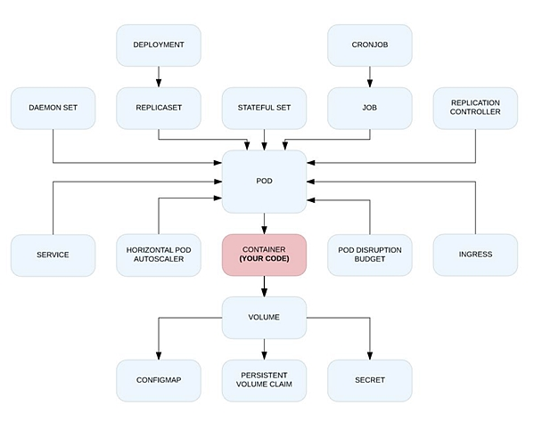
Application dependency on Kubernetes primitives
Source: Kubernetes effect by Bilgin Ibryam

Slide 25
Kubernetes effect on software development life cycle
Distributed Primitives
CN- Design Principles
ContainerDesign Patterns
Best Practices
Cloud Native Benefits
Source: Kubernetes effect by Bilgin Ibryam

Slide 26
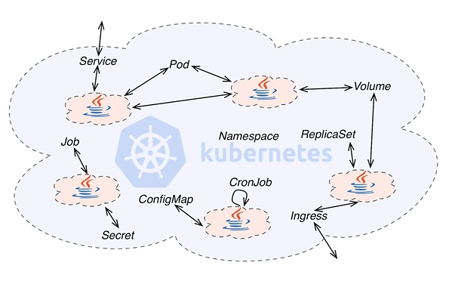
Local and distributed abstractions and primitives
Source: Kubernetes effect by Bilgin Ibryam

Slide 27
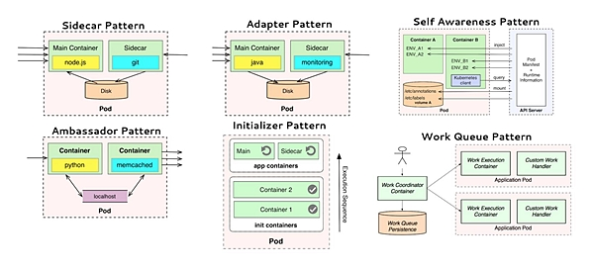
Local and distributed abstractions and primitives
Source: Kubernetes effect by Bilgin Ibryam

Slide 28
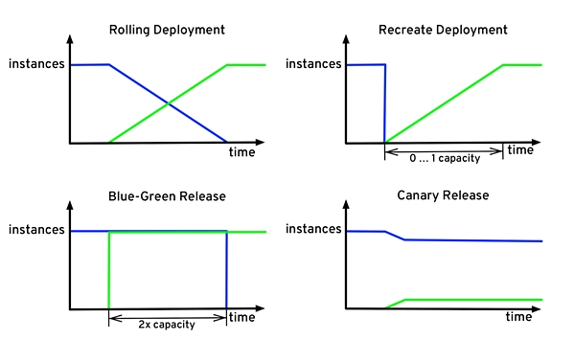
Deployment and Release Strategy with Kubernetes
Source: Kubernetes effect by Bilgin Ibryam

Slide 29
Getting started with Kubernetes
Kubernetes.IO documentation → && Kubernetes Bootcamp →
Install Kubernetes CLI kubectl
Create a local cluster with Minikube, Tectonic, MiniShift
Create a Kubernetes cluster on GKE
Create a Kubernetes cluster on AWS
Kubeadm →
Kops FastStart →
Kubicorn →
TK8 →

Slide 30
Install Kubernetes CLI kubectl
On macOS: brew install kubectl
On linux and windows follow the official documentation: https://kubernetes.io/docs/tasks/tools/install-kubectl/
“kubectl version” gives the client and server version
“which kubectl”
alias k=’kubectl’
Enable shell autocompletion (e.g. on linux):
echo "source <(kubectl completion bash)" >> ~/.bashrc
Notes:
Note: the kubectl bash completion doesn’t work out of the box if you set alias k=’kubectl’
You need to do:
kubectl completion bash | sed -e 's/kubectl/k/g'
On Mac the above doesn’t work, to fix this to the following: kubectl completion bash | sed -e 's/kubectl/k/g' >> ~/.kubectl-short-completion.bash
Source .kubectl-short-completion.bash in your .bash_profile:
source ~/.kubectl-short-completion.bash

Slide 31
kubectx and kubens tools
Great kubectl helpers by Ahmet Alp Balkan
kubectx and kubens →
Kubernetes prompt for bash and zsh
kube-ps1 →
Kubed-sh (kube-dash) →

Slide 32
Useful aliases
alias k="kubectl"
alias g="gcloud"
alias kx="kubectx"
alias kn="kubens"
alias kon="kubeon"
alias koff="kubeoff"
alias kcvm="kubectl config view --minify"
alias kgn="kubectl get nodes"
alias kgp="kubectl get pods"
Notes:
merge 2 kube config files: KUBECONFIG=~/.kube/config:./kube.config kubectl config view --flatten --> config
cp config ~/.kube/config

Slide 33
Local Development Environment using Minikube
Follow the best Minikube tutorial ever by the awesome Abhishek Tiwari
https://abhishek-tiwari.com/local-development-environment-for-kubernetes-using-minikube/

Slide 34
Create a Kubernetes cluster on GKE (1)
You need an account on GCP with billing enabled
Create a project and enable GKE service
Install gcloud SDK / CLI:
https://cloud.google.com/sdk/
Source:

Slide 35

Create a Kubernetes cluster on GKE (2)
gcloud projects create kubernauts-trainings
gcloud config set project kubernauts-trainings
gcloud container clusters create my-training-cluster --zone=us-central1-a
Note: message=The Kubernetes Engine API is not enabled for project training-220218. Please ensure …
Kubectl get nodes

Slide 36
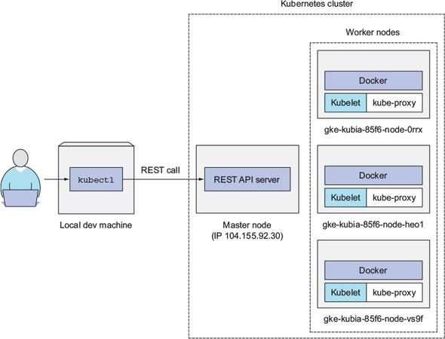
How you’re interacting with your three-node Kubernetes cluster
Source: Kubernetes in Action book by Marko Lukša

Slide 37
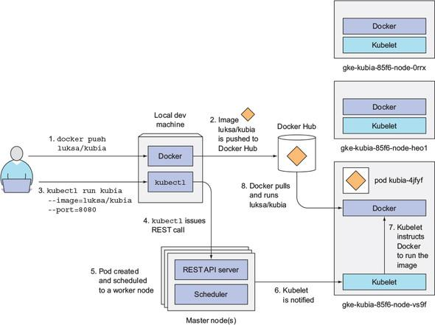
Running the container image in Kubernetes
Source: Kubernetes in Action book by Marko Lukša

Slide 38
Create a Kubernetes cluster on GKE (3)
List your clusters
gcloud container clusters list
Set a default Compute Engine zone
gcloud config set compute/zone us-central1-a
Define a standard project with your ProjectID
gcloud config set project kubernauts-trainings
Access the Kubernetes dashboard
kubectl proxy →
Source:

Slide 39
Create a Kubernetes cluster on GKE (4)
Login to one of the nodes
gcloud compute ssh <node-name>
Get more information about a node
kubectl describe node <node name>
Delete / clean up your training cluster
gcloud container clusters delete my-training-cluster --zone=europe-west3-a
Note: deleting a cluster doesn’t delete your storage / disks on GKE, you’ve to delete them manually
Source:

Slide 40
Create a Kubernetes cluster on AWS / OpenStack
Create a Kubernetes cluster on AWS
Kubdeadm →
Kops FastStart →
Kubicorn →
TK8 → (supports OpenStack as well, Bare-Metal, Azure, GCP coming soon)

Slide 41
Create a Kubernetes cluster on ACS
Create a Kubernetes cluster on ACS
ToDo → see Kubernetes CookBook
Source:

Slide 42
Kubernetes API Groups, OpenAPI and Swagger UI (1)
Install Swagger UI on Minikube / Minishift / Tectonic
k run swagger-ui --image=swaggerapi/swagger-ui:latest
On Tectonic →
k expose deployment swagger-ui --port=8080 --external-ip=172.17.4.101 --type=NodePort
On Minikube →
k expose deployment swagger-ui --port=8080 --external-ip=$(minikube ip) --type=NodePort
Use swagger.json to explore the API
Notes:
Note: this doesn’t work on minikube: minikube start --extra-config=apiserver.Features.Enable-SwaggerUI=true k proxy --port=8080
http://127.0.0.1:8080/swagger-ui

Slide 43
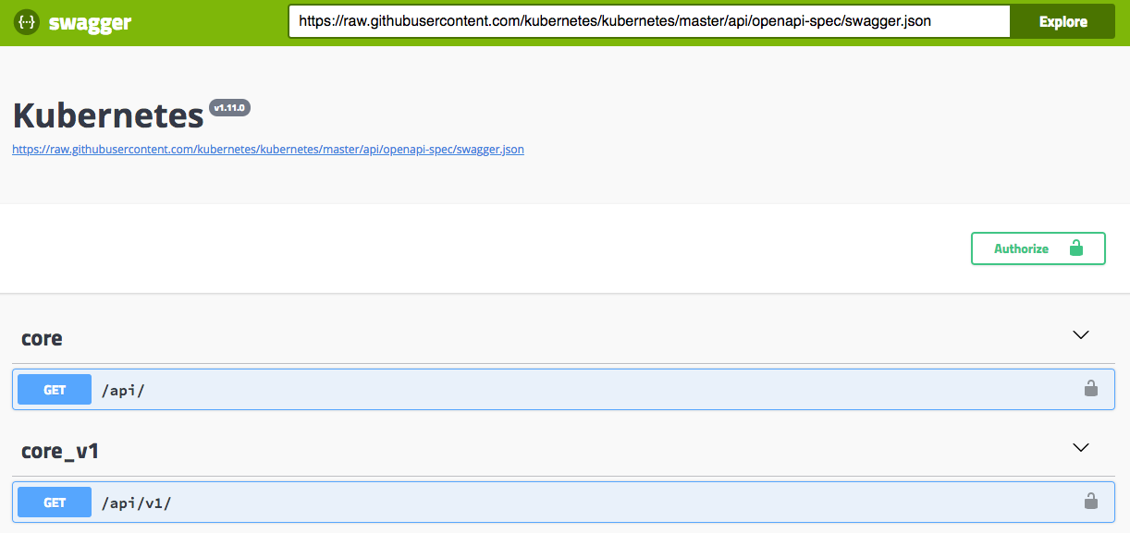
Kubernetes API Groups, OpenAPI and Swagger UI (2)

Slide 44
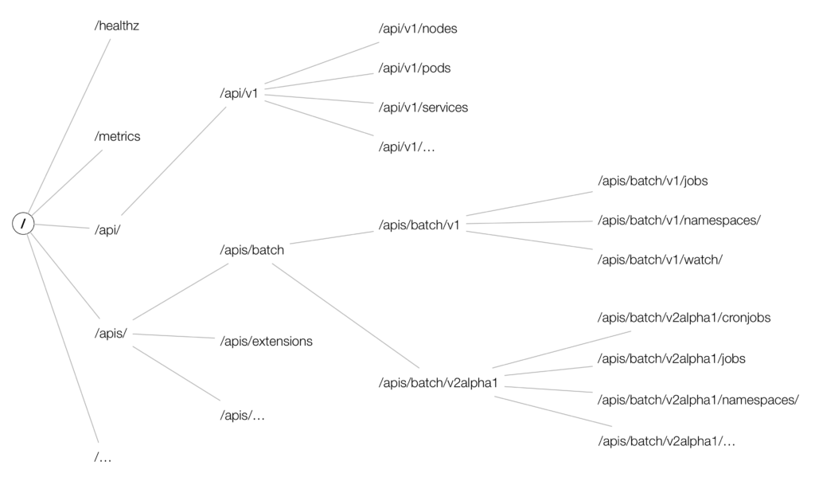
Kubernetes API Groups, OpenAPI and Swagger UI (3)
Enjoy the Kubernetes API deep dive →

Slide 45

Play with Simple Apps on Kubernetes
Start the Ghost micro-blogging platform
kubectl run ghost --image=ghost:0.9
kubectl expose deployments ghost --port=2368 --type=LoadBalancer
k expose deployment ghost --port=2368 --external-ip=$(minikube ip) --type=NodePort
kubectl get svc
kubectl get deploy
kubectl edit deploy ghost (change the nr. of replicas to 3)

Slide 46
Play with Simple Apps on Kubernetes
Log into the pod
kubectl exec -it ghost-xxx bash
Get the logs from the pod
kubectl logs ghost-xxx
Delete the Ghost micro-bloging platform
kubectl delete deploy ghost
Get the cluster state
kubectl cluster-info dump --all-namespaces --output-directory=$PWD/cluster-state

Slide 47
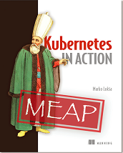

Deploying and Updating Apps with Kubernetes
Please read and understand this great free chapter from Kubernetes in Action book by Marko Lukša.

Slide 48
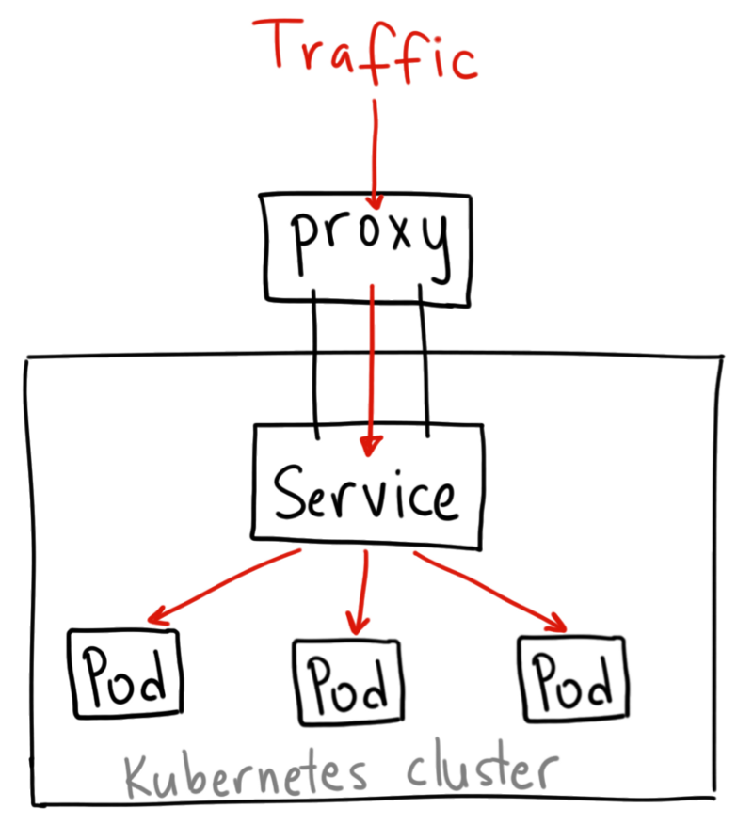
Understanding Kubernetes NodePort vs LoadBalancer vs Ingress
Source: https://medium.com/google-cloud/kubernetes-nodeport-vs-loadbalancer-vs-ingress-when-should-i-use-what-922f010849e0

Slide 49
Kubernetes ingress with Ambassador
Ambassador is an open source, Kubernetes-native microservices API gateway built on the Envoy Proxy.
Ambassador is awesome and powerful, eliminates the shortcomings of Kubernetes ingress capabilities
Ambassador is easily configured via Kubernetes annotations
Ambassador is in active development by datawire.io
Needles to say Ambassador is open source →
Source: https://blog.getambassador.io/kubernetes-ingress-nodeport-load-balancers-and-ingress-controllers-6e29f1c44f2d

Slide 50

Kubernetes by Example
By the awesome Kubernaut Michael Hausenblas
Hands-On introduction to Kubernetes →
Note: you can run the examples on minikube, OpenShift, GKE or any other Kubernetes Installations.

Slide 51

Kubernetes Presentations and Tutorials by Bob Killen
By the awesome Bob Killen
Introduction to Kubernetes →
Kubernetes Tutorials →

Slide 52
More Exercises

Slide 53
Exercise 1: Create a deployment for nginx ...
Create a deployment running nginx version 1.12.2 that will run in 2 pods
Scale this to 4 pods
Scale it back to 2 pods
Upgrade the nginx image version to 1.13.8
Check the status of the upgrade
Check the history
Undo the upgrade
Delete the deployment
Source:

Slide 54
Exercise 1: Create a deployment for nginx ...
Create nginx version 1.12.2 with 2 pods
kubectl run nginx --image=nginx:1.12.2 --replicas=2 --record
Scale to 5 pods
kubectl scale --replicas=5 deployment nginx
Scale back to 2 pods
kubectl scale --replicas=2 deployment nginx
Upgrade the nginx image to 1.13.8 version
kubectl set image deployment nginx nginx=nginx:1.13.8
Source:

Slide 55
Exercise 1: Create a deployment for nginx ...
Check the status of the upgrade
kubectl rollout status deployment nginx
Get the history of the actions
kubectl rollout history deployment nginx
Undo / rollback the upgrade
kubectl rollout undo deployment nginx
Delete the deployment
k delete deploy/nginx
Source:

Slide 56
Exercise 1: Create a deployment for nginx from a manifest file
$ cat nginx.yaml
apiVersion: extensions/v1beta1
kind: Deployment
metadata:
name: nginx
labels:
app: nginx
spec:
replicas: 2
selector:
matchLabels:
app: nginx
template:
metadata:
labels:
app: nginx
spec:
containers:
- name: nginx
image: nginx:1.12.2
ports:
- containerPort: 80
Create the deployment with a manifest:
kubectl create -f nginx.yaml
Note: Pods, services, configmaps, secrets in our examples are all part of the /api/v1 API group, while deployments are part of the /apis/extensions/v1beta1 API group.
The group an object is part of is what is referred to as apiVersion in the object specification, available via the API reference.

Slide 57
Exercise 1: Create a deployment for nginx ...
Edit the deployment: change the replicas to 5 and image version to 1.13.8
kubectl edit deployment nginx
Get some info about the deployment and ReplicaSet
kubectl get deploy
kubectl get rs
k get pods -o wide (set alias k=’kubectl’)
K describe pod nginx-xyz

Slide 58
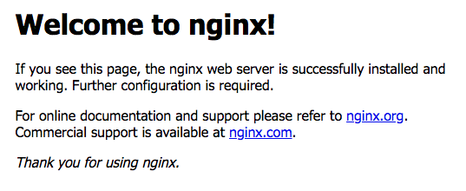
Exercise 1: Create a service to the pods with expose
kubectl expose deployments nginx --port=80 --type=LoadBalancer
k get svc

Slide 59
Exercise 2: write an ingress rule ...
Write an ingress rule that redirects calls to /foo to one service and to /bar to another
k create -f ingress.yaml
$ cat ingress.yaml
apiVersion: extensions/v1beta1
kind: Ingress
metadata:
name: test
annotations:
ingress.kubernetes.io/rewrite-target: /
spec:
rules:
- host: kubernauts.io
http:
paths:
- path: /foo
backend:
serviceName: s1
servicePort: 80
- path: /bar
backend:
serviceName: s2
servicePort: 80

Slide 60
Exercise 3: deployment, RC & RS
kubectl run kubia --image=luksa/kubia --port=8080 --generator=run/v1
kubectl run kubia --image=luksa/kubia --port=8080
k get svc
k get pods
k get rc
k get rs
kubectl describe rs kubia-57478bf476
k get svc
k expose rc kubia --type=LoadBalancer --name kubia-http
k expose rs kubia --type=LoadBalancer --name kubia-http2
k expose rs kubia-57478bf476 --type=LoadBalancer --name kubia-http2
k get pods
k scale rc kubia --replicas=3
k get pods
k scale rs kubia-57478bf476 --replicas=3 —> can’t work, you should scale the deployment
k scale deployment kubia --replicas=3 K port-forward kubia-xxxxx 8888:8080
http://127.0.0.1:8888/
Note: the kubia image is from the Kubernetes in Action book by Marko Lukša

Slide 61
Exercise 4: horizontal pod autoscaling (hpa)
On GKE:
kubectl run ghost --image=ghost:0.9 --requests="cpu=100m"
k expose deployment ghost --port=2368 --type=LoadBalancer
k autoscale deployment ghost --min=1 --max=4 --cpu-percent=10
export loadbalancer_ip=$(k get svc -o wide | grep ghost | awk '{print $4}')
while true; do curl http://$loadbalancer_ip:2368/ ; done
k get hpa -w
k describe hpa
On Minikube (hpa doesn’t work for now on minikube → bug??)
minikube addons enable heapster
kubectl run ghost --image=ghost:0.9 --requests="cpu=100m"
k expose deployment ghost --port=2368 --type=NodePort --external-ip=$(minikube ip)
k autoscale deployment ghost --min=1 --max=4 --cpu-percent=10
while true; do curl http://$(minikube ip):2368/ ; done
k get hpa -w
k describe hpa
→ unable to get metrics for resource cpu

Slide 62
Exercise 5: deploying replicated stateful applications
gcloud compute disks create --size=1GiB --zone=us-central1-a pv-a
gcloud compute disks create --size=1GiB --zone=us-central1-a pv-b
gcloud compute disks create --size=1GiB --zone=us-central1-a pv-c
k create -f persistent-volumes-gcepd.yaml
k create -f kubia-service-headless.yaml
k create -f kubia-statefulset.yaml
k get po
k get po kubia-0 -o yaml
k get pvc
k proxy
k create -f kubia-service-public.yaml
k proxy
Note: This example is from the Chapter 10 of the Kubernetes in Action book by Marko Lukša

Slide 63
Exercise 6: Play with RBAC
minikube stop
minikube start --extra-config=apiserver.Authorization.Mode=RBAC
k create ns foo
k create ns bar
k run test --image=luksa/kubectl-proxy -n foo
k run test --image=luksa/kubectl-proxy -n bar
k get po -n foo
k get po -n bar
k exec -it test-xxxxxxxxx-yyyyy -n foo sh
k exec -it test-yyyyyyyyy-xxxxx -n bar sh
curl localhost:8001/api/v1/namespaces/foo/services
curl localhost:8001/api/v1/namespaces/bar/services
cd Chapter12/
cat service-reader.yaml
k create -f service-reader.yaml -n foo
k create role service-reader --verb=get --verb=list --resource=services -n bar
k create rolebinding test --role=service-reader --serviceaccount=foo:default -n foo
k create rolebinding test --role=service-reader --serviceaccount=bar:default -n bar
k edit rolebinding test -n foo
k edit rolebinding test -n bar
Note: This example is from the Chapter 12 of the Kubernetes in Action book by Marko Lukša

Slide 64
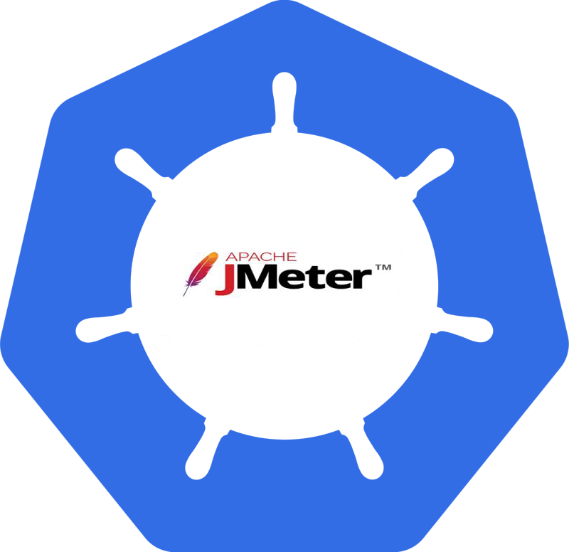
Exercise 7: Load Testing with Apache Jmeter on Kubernetes and OpenShift
A more complete example: https://goo.gl/k5rFpb

Slide 65
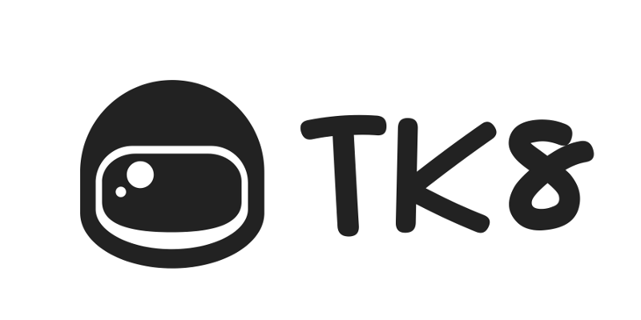
Exercise 8: Running Rancher on Kubernetes
TK8 on Github: https://github.com/kubernauts/tk8

Slide 66

Exercise 9: Kafka Confluent on Kubernetes or OpenShift
Github link:
https://github.com/kubernauts/kafka-confluent-platform

Slide 67

Exercise 10: Cassandra on Kubernetes
Github link: coming soon

Slide 68
Appendix (1)
Run Minikube with RKT or CRI-O
minikube start --container-runtime=rkt --network-plugin=cni
minikube start --container-runtime=crio --network-plugin=cni

Slide 69
Get in Touch
Slack - https://kubernauts-slack-join.herokuapp.com/
#kubernetes-teachers on https://kubernetes.slack.com
GitHub - https://github.com/kubernauts
Twitter - @kubernauts
Meetup group - https://www.meetup.com/kubernauts/
And finally, kubernauts.io

